Slide 1
AWS Intensive
WELCOME!
Fernando Pombeiro
Notes:
[Mandatory Slide]
ACTION: Adjust title, name, info, etc.

Slide 2

Container management

Slide 3
Managing docker containers
Obviously containerization has become a major force in modern programming (if you’re not using it I suggest that you look into it!)
Containerization is basically a way to use Docker Containers to wrap code.
Docker containers ARE a form of Infrastructure-as-code- that infrastructure coming in the form of docker files which we demonstrated in lesson one.

Slide 4
Container management
So another big advantage of keeping your infrastructure-as-code is that you can have your developers create local environments based on infrastructure documents in the cloud.
This can save you a TON of issues around re-creating the production environment for development and testing locally.
If you’ve ever used the “Golden Image” to provision servers before you’re familiar with the difficulties of maintaining the STATE of an environment for testing.

Slide 5
Container management (cont’d)
So like any other codebase we would like to keep some sort of version control for our infrastructure code. This gives us a lot of the advantages of version control in our code base including things like keeping old versions of your infrastructure code to roll back to in case of an error.
So ideally in this situation we would have some sort of repo similar to a github repository setup where we could store IMAGES from our DOCKERFILES.

Slide 6
Container Management (continued)
AWS provides a repository method for DOCKER IMAGES that your developers could use to develop from. You can push these images directly to production from the repository master branch and guarantee that the image in the repo (read- the environment) will match what’s in production.
The advantage here is also that you can pass an image down to your devs, they do work on the codebase, wrap up the code into an image, and pass it back and we can deploy that image directly.

Slide 7
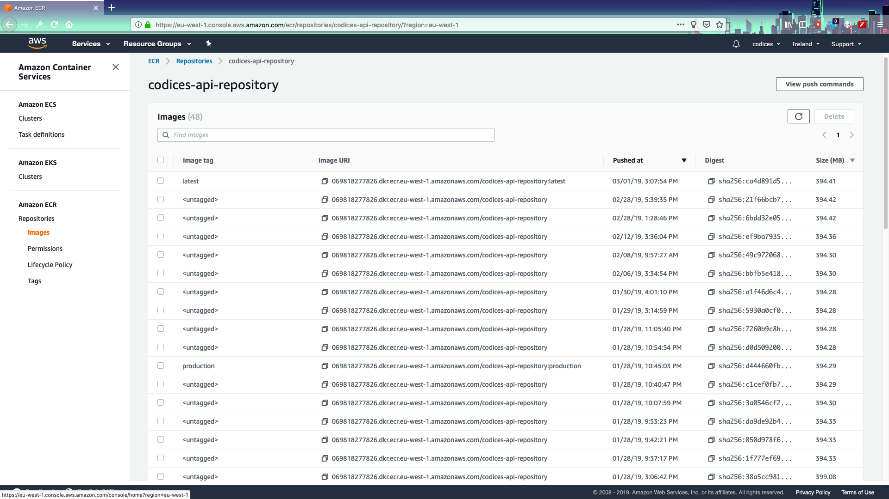
Elastic Container Registry (ECR
So the elastic container registry (ecr) in AWS allows customers a private registry that will allow devs to pull, push, and deploy images while maintaining previous versions.

Slide 8
ECR Workflow
So the Elastic Container Registry workflow is as follows:
DevOps pushes an initial base image to the repository
Developers pull the base image and do some work on the code.
Developers build (and locally run) the image that was pulled from the devops repo. Once they have proven that it works locally and it is ready to go…
Developers PUSH the updated image BACK to the repository with a tag that states the version.
Dev/OPS deploys the image to the EC2 cluster

Slide 9
Clusters in ECS
So the next logical question is: where do we deploy the images to? WELL- AWS ECS comes with CLUSTERS that run the containers that you send.
These clusters are ec2 instances that run your containers. The ec2 instances are completely run by AWS- you don’t touch them or have anything at all to do with them. Your only concern is your containers.
To set up this system you run your container as a task on a service

Slide 10
Clusters in ECS (continued)
So this service is the logical hierarchy of how we want to run our containers. The service decides things like:
How many containers we want running at a base level
How many containers we want to expand to if containers start getting over N percent of CPU
What base image we want to use (basically which tag we want to use)
Any environment variables we want to add or overwrite in the container.

Slide 11
ECS Cluster management
The biggest advantage of service logic is it’s ability to expand and contract based on the load.
For example: let’s say you have some code that does transformation on a data stream. The incoming streaming data is, let’s say, betting odds (that change constantly).
As you can imagine the flow of this data would be extremely uneven….on slow times (with no matches) there would be very few odds changes while during matches it goes crazy.

Slide 12
ECS service management
So your incoming demand for your service might look something like this- pretty uneven until a match…

Slide 13
ECS Service management
So the service in the ECS cluster can have logic that says:
“When you get to 70% CPU utilization- go ahead and spin up another container to take some of that load. Follow this logic through between 2 and 50 containers. When you see the container demand going down…kill them off”.
This (obviously) gives us a tremendous amount of elasticity in how we manage incoming demand on our AWS resources. This saves on COST and still leaves us very little to actually manage.

Slide 14
Create a cluster
We’re going to create a cluster together to show everyone how easy this is to do. For this exercise we’re going to walk through deploying a basic API back end using another github category that I have created.
Use this github link and the node file in module_05 https://github.com/ferninphilly/deploy-to-fargate

Slide 15
Deploying to Fargate
So for this project we’re going to use a very basic node.js express application that does nothing but give quotes from THE ROOM. The node application is written in node 11.
cd into the module_05/fargateapp directory to see it and if you want to run it just type node index.js.
Now let’s deploy it to fargate! (We’re going to do this without terraform for now just as an example).

Slide 16
Elastic Load Balancer

Slide 17
Elastic Load Balancer
SO- we have our Tommy Wiseau quote app set up locally and deployed to fargate BUT…we still need a way to access it from the internet. Let’s talk LOAD BALANCERS.
So LOAD BALANCERS are basically just what the name implies: they manage incoming requests and send data to a service.
We can make ECS into a service and direct traffic towards them fairly simply!

Slide 18
Elastic Load Balancer
There are two types of elastic load balancers:
Application Load Balancers: Usually used for http/https communications application load balancers are intended, usually, for external communications with the internet. If you have a service (like our Tommy Wiseau quoting service) then you would use an ALB to manage the incoming http(s) requests and direct them to the appropriate container service.
Network Load Balancers: these work mostly in the TCP/TLS realm and deal with internal items to your application- not often from HTTP(s) – though the CAN be.

Slide 19
Load Balancers
Load balancers come with some phenomenal advantages- like health checks- basically pings to your service that check to see if it is available. This means that you can default the ELB to send 404 in the case of a failed health check to your service.
Load balancers aim for target groups which are really just synonyms for services.
ELBs can be set up to accept incoming connections from domains you have purchased (though AWS route 53 for example).

Slide 20
ECS set up as a target group
ELBs can also route traffic through a really easy-to-use interface that allows you to send traffic to various places once it hits the ELB.
You can define these routes and rules and therefore be set up to accept routes on sub-domains like /api/v1 for example.
Check out the rules section for more on this.

Slide 21
Confused????
GOOD! Ask Questions!!

